Slide 1

Step Response
of RL Circuit
報告人:邱少譽

Slide 2
category
01
04
summary
02
03
problems
the state condition
step response ‘s constitute

Slide 3
01
summary

Slide 4
Summary
The forced response is what the circuit does with the sources turned on,
but with the initial conditions set to zero(stored energy + independent source)
The natural response is what the circuit does including the initial conditions,
but with the input suppressed.
The total response is the sum of the forced response plus the natural response.
These responses can be combined using the principle of superposition
(temporary part + permanent part)

Slide 5
02
STEP RESPONSE’s constitute

Slide 6
Total response
Total response (usually seen as this two directions)
1.natural response + forced response
(stored energy + independent source)
2. Homogeneous solution + Particular solution
(temporary part + permanent part)

Slide 7

Main steps
1.carry out t=0- &t=>∞(initial and final state)
2.obtain solution to differential equation
3.Then you will find the answer
Important formula
For inductor

Slide 8
03
The state condition

Slide 9
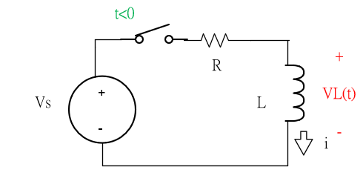
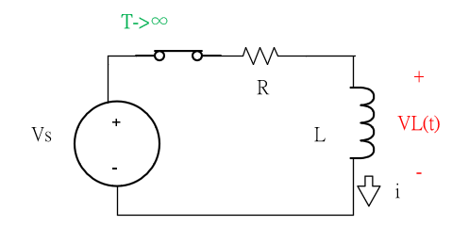
Initial state &final state
At that time, the inductor becomes a short circuit, and the voltage across
it is zero. The entire source voltage appears across R. Thus,
the steady-state response is.

Slide 10
Examples solving basic circuits
The method for solving a circuit driven by an external source is:
1.Set the initial conditions to 0 and solve the forced response.
2.Set the input to 0, and solve the natural response.
3.Add forced response to the natural response to get total response.
4. Use the initial conditions to resolve any constants.

Slide 11
04
problems

Slide 12
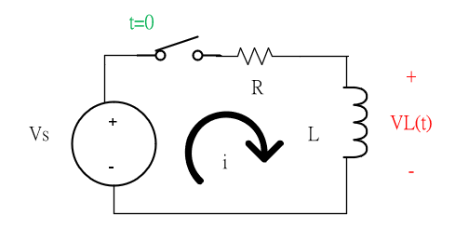
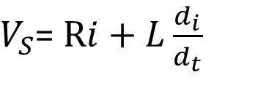
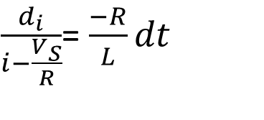
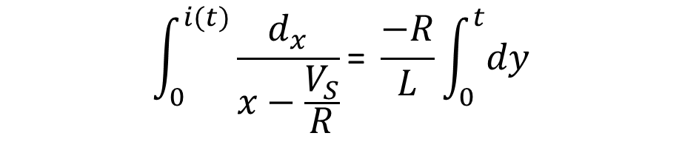
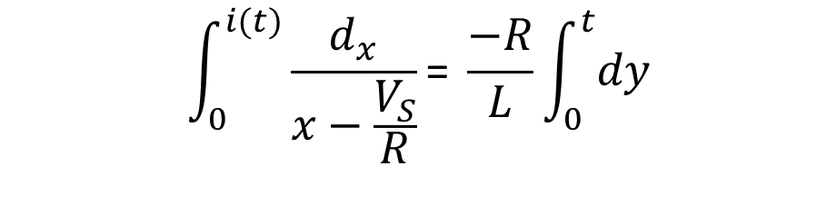
Examples solving basic circuits
$V_{S}$= $Ri+L\frac{d_{i}}{d_{t}}$
$\frac{d_{i}}{i−\frac{V_{S}}{R}}$= $\frac{−R}{L}dt$
$$\int_{0}^{i(t)}{\frac{d_{x}}{x−\frac{V_{S}}{R}}\text{= }\frac{−R}{L}\int_{0}^{t}{dy}}$$
$$\int_{0}^{i(t)}{\frac{d_{x}}{x−\frac{V_{S}}{R}}\text{= }\frac{−R}{L}\int_{0}^{t}{dy}}$$

Slide 13
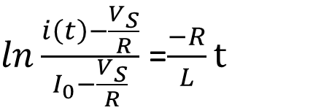
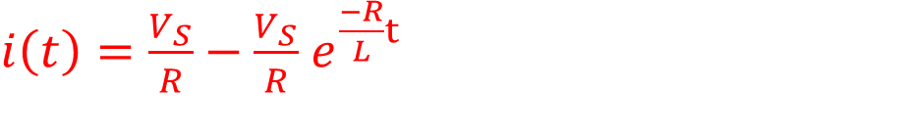
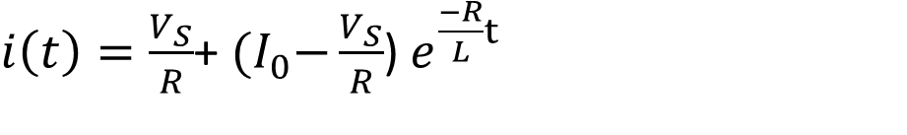
Examples solving basic circuits
$ln\frac{i\left(t\right)−\frac{V_{S}}{R}}{I_{0}−\frac{V_{S}}{R}}$ =$\frac{−R}{L}t$
$i\left(t\right)=\frac{V_{S}}{R}$+ ${(I}_{0}−\frac{V_{S}}{R}$) $e^{\frac{−R}{L}t}$
$i\left(t\right)=\frac{V_{S}}{R}−\frac{V_{S}}{R}$ $e^{\frac{−R}{L}t}$

Slide 14
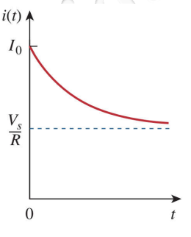
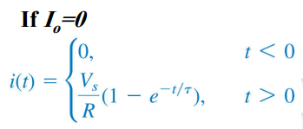

Step Response of an RL Circuit
We can also written as
i(t)$=\text{i}\text{(}∞\text{)}\text{+[}\text{i}\text{(0)−}\text{i}\text{(}∞\text{)}\text{]}e^{−\frac{t}{\text{τ}}}$
$i\left(t\right)=\frac{V_{S}}{R}−\frac{V_{S}}{R}$ $e^{\frac{−R}{L}t}$

Slide 15
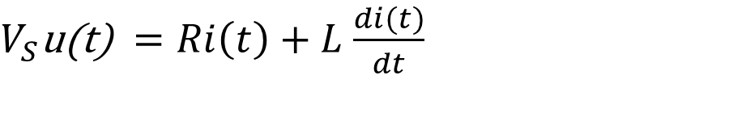

Solving basic circuits(by laplace transform)
$$V_{S}\text{(}\text{t}\text{)=}V_{S}\text{u}\text{(}\text{t}\text{)}$$
$V_{S}\text{u}\text{(}\text{t}\text{)} =Ri\left(t\right)+L$ $\frac{di(t)}{dt}$
$\frac{V_{S}}{S}=$ $Ri\left(s\right)+L[sI\left(s\right)−i\left(0^{−}\right)]$
$\frac{V_{S}}{S}=$ $Ri\left(s\right)+sLI\left(s\right)$
$\frac{V_{S}}{S}=$ $Ri\left(s\right)+sLI\left(s\right)$

Slide 16
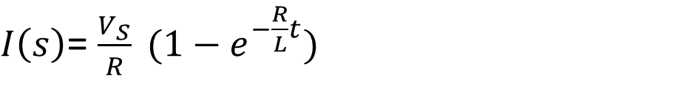
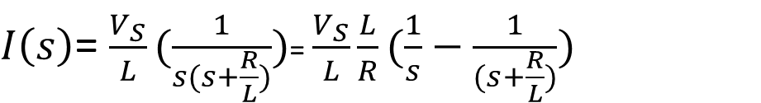
Solving basic circuits(by laplace transform)
$\frac{V_{S}}{S}=$ $I\left(s\right)(R+sL)$
$I\left(s\right)$= $\frac{V_{S}}{s(R+sL)}$
$I\left(s\right)$= $\frac{V_{S}}{L}(\frac{1}{s(s+\frac{R}{L})})$= $\frac{V_{S}}{L}\frac{L}{R}(\frac{1}{s}−\frac{1}{(s+\frac{R}{L})})$
$I\left(s\right)$= $\frac{V_{S}}{R} (1−e^{−\frac{R}{L}t})$

Slide 17
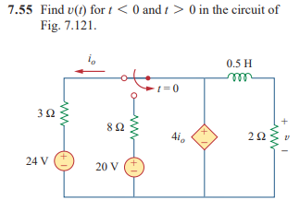
problem1
ANS:i(t)=48e^(-4t),v(t)=96e^(-4t)

Slide 18
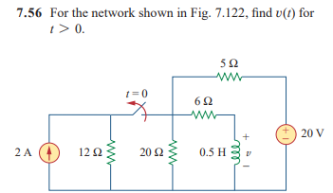
problem2
ANS:V(t)=-4e^(-20t))

Slide 19
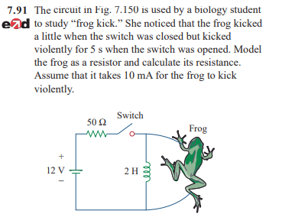
problem3
ANS:R=1.271

Slide 20
Reference
fundamental of electric circuits alexander
https://www.khanacademy.org/science/electrical-engineering/ee-circuit-analysis-topic/ee-natural-and-forced-response/a/ee-rc-step-response
https://electronics.stackexchange.com/questions/93061/difference-between-natural-response-and-forced-response

Slide 21
Electric circuits
THANKS
報告人:邱少譽

